Slide 1
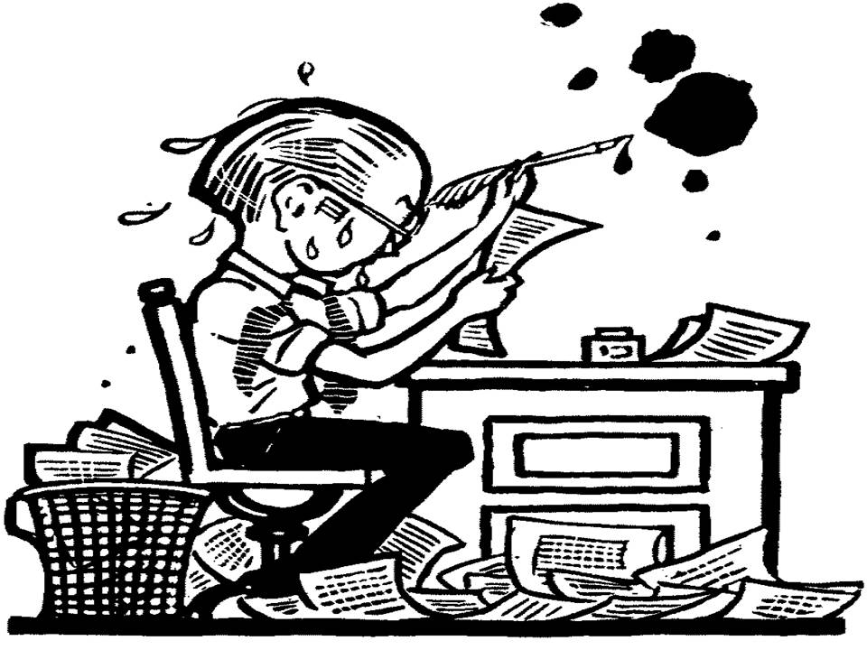
English II Honors Catcher ICE Revision DAY ONE
The Scarlet Letter
ICE Revision

Slide 2
READ
Read your entire essay from beginning to end.
Too often, students merely write words and never pause to read what they have actually written.
Take that time and do it now.
Write nothing…just acquaint / re-acquaint yourself with your essay.

Slide 3
INTRODUCTION
Read your entire introductory paragraph.
Do you move from the general (attention getter) to the specific (CLAIM) with explanatory information to build in that direction?
If not, what can you alter to suit this expected framework?

Slide 4
ATTENTION GETTER
Highlight/underline the opening sentence of your essay.
Does it compel attention from a reader, student, teacher, student-teacher, or any other organism that breathes?
If so, why does it?
If not, what can you do to compel a greater sense of attention?
Is it a general idea that definitively will tie into the claim?

Slide 5
CLAIM
Highlight / underline your claim.
Do you have one?
Is it a specific one sentence statement?
Is it the final sentence of your introduction?
Does it discuss the author’s statement ABOUT this theme?
If it only references the novel, what can you do to modify it to include the above ideas?

Slide 6
THEME
Examine your analysis of Salinger’s statement regarding the thematic concept you selected.
Do you expand upon the theme with discussion of Salinger’s message in each body paragraph?
Have you discussed this from various viewpoints in your essay? (characters, documentary, articles)
…or do you merely repeat the theme over and over again?

Slide 7
SUPPORTING PARAGRAPHS
Read each of your supporting paragraphs.
Do you return to the author’s message regarding the chosen theme in each paragraph?
Do you step beyond the characters and plot to examine the author’s message?
If not, what can you add to delve deeper into the author’s message?

Slide 8
TEXTUAL SUPPORT
Scan your essay for the quotes from the novel/articles.
How often do you refer to text?
Do you blend direct and indirect citations within each body paragraph?
Is the incorporation of the quotations smooth and fluid?
Do you use too much textual support?
…or not enough?
Do the chosen quotations exemplify your overall point of the paragraph, claim, essay?

Slide 9
QUOTATION INTEGRATION
Do you smoothly integrate a small portion of text INTO the middle of your own sentences?
Do you:
Properly use brackets and ellipses when making changes to a quote?
Change quote without altering original meaning of quote?
Use “he says” or “this shows” types of introductions/follow ups?—Get rid of these types of phrases.
Refer to my Summer Read note sheet for samples

Slide 10
WELL INTEGRATED QUOTES
EXAMPLE:
After all, he believes that he “won’t run into anything [he] can’t deal with on [his] own” (Krakauer 6).
EXAMPLE:
Though Krakauer sees McCandless as “a raw youth who mistook passion for insight,” (155) he still emphasizes that this Alaskan journey is key to shaping McCandless because it forces a maturity and self-reliance on Chris far greater than he’s known up to this point.

Slide 11
CONCLUSION
Read the entire concluding paragraph.
Does it summarize the essential points of the essay?
Is the pathway of logic a movement from the specific to the general with explanatory information building in that direction?
DO YOU FORM A FINAL THOUGHT?
Did you write your conclusion with a clear, intentional idea in mind?
…or was it merely an afterthought of rushed ideas as the period came to a close?

Slide 12
English II Honors Catcher ICE Revision DAY TWO
The Scarlet Letter
ICE Revision

Slide 13
WORD CHOICE
Examine your pronoun usage.
Do you incorrectly use first person pronouns, such as I, me, my, mine, we, us, our, ours, etc.?
Do you incorrectly use second person pronouns, such as you, your, yours, etc.?
Do you correctly use third person pronouns, such as he, she, it, they, etc.?
Do you refer to the reader or one…STOP IT!
Do you ever use the abomination of language…THEMSELF? It’s not a word…it’s a contradiction in terms…STOP IT!

Slide 14
WORD CHOICE
Examine the specificity and firmness of your language.
Are there instances where your language does not paint a picture, or the chosen words cast doubt upon your intended message?
Do you use words such as things, stuff, a lot, etc.?
Do you use words such as almost, kind of, sort of, maybe, possibly, etc.?
How will you rephrase your sentence to be more specific and firm with your message?

Slide 15
WORD CHOICE
Examine your essays for any misspelled words.
If there’s a shred of doubt, look it up!
Some of the most common misspelled words from sophomores are:
beginning, definitely, loneliness, separate, their/there/they’re, loose/lose, choose/chose, woman/women, receive, Phoebe, Caulfield

Slide 16
SENTENCE STRUCTURE
Examine each sentence and its possible incorrect structure.
Do you have variety in your sentence length and complexity?
Have you written a fragment, run-on sentence, or comma splice? Would you know one if you saw one?
If you have written one, what can you do to correct the issue?
Can any of these structures ever be used and not be seen as incorrect grammar?

Slide 18
PUNCTUATION
Use the following forms of punctuation at least once (each) throughout your essay.
SEMICOLON: combines two complete, related sentences; connects a series that has internal commas
COLON: sets off an explanation or list; announces; can be used before a word, phrase or sentence
DASH: works in place of a comma, semicolon or colon; more emphatic than a comma; more connective than a colon; can be used before a word, phrase or sentence; can be used to set off an appositive in the middle of a sentence
PARENTHESES: works like an aside or a sidebar, to include information that is not wholly relevant

Slide 19
MLA FORMAT
MLA requires:
Proper heading (1st page only) and headers
Double space throughout
12 point font
1 inch margins
PLAIN font (Times New Roman, Calibri, Arial)
**MLA does not require you to title your essay, but if you do, please make sure the title is original. The Catcher in the Rye ICE Revision, In class essay, The Catcher in the Rye , etc. are NOT original titles. Also, the title of your essay should be in plain font—NO bold, underlining, italics, or quotation marks.

