Slide 1
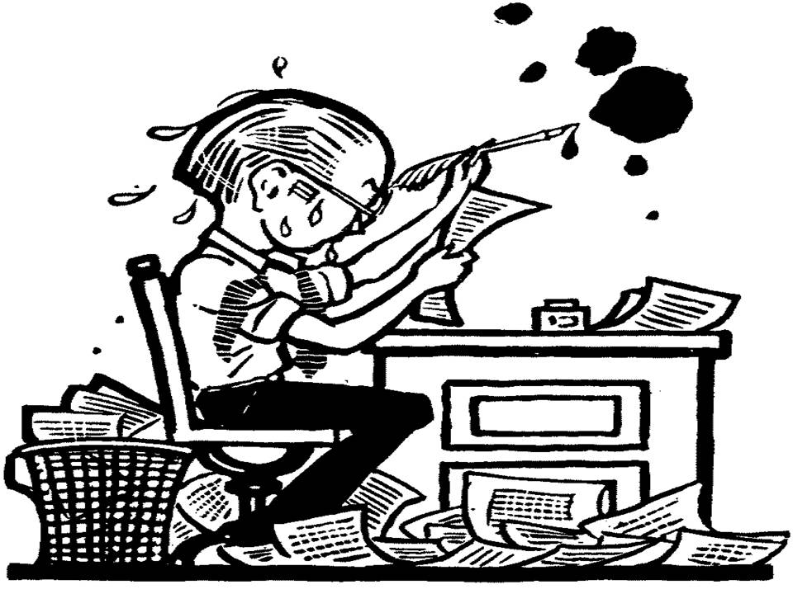
English II Honors SL ICE Revision
The Scarlet Letter
ICE Revision

Slide 2
READ
Read your entire essay from beginning to end.
Too often, students merely write words and never pause to read what they have actually written.
Take that time and do it now.
Write nothing…just acquaint / re-acquaint yourself with your essay.

Slide 3
INTRODUCTION
Look at your introductory paragraph.
Do you move from the general (attention getter) to the specific (CLAIM) with explanatory information to build in that direction?
If not, what can you alter to suit this expected framework?

Slide 4
ATTENTION GETTER
Highlight the opening sentence of your essay.
Does it compel attention from a reader, student, teacher, student-teacher, or any other organism that breathes?
If so, why does it?
If not, what can you do to compel a greater sense of attention?
Is it a topically appropriate sentence or do you begin with musings about writing since the dawn of time?

Slide 5
CLAIM
Highlight / underline your claim.
Do you have one?
Is it the final sentence of your introduction?
Does it discuss the author’s message ABOUT this theme?
Does it make a brief statement about how the message contributes to the overall structure?
Does it reference characters by name? If so, cut them out.

Slide 6
SUPPORTING PARAGRAPHS
Read each of your supporting paragraphs.
Is your topic sentence an argument that stems from your claim?
Is your topic sentence about a character? If so, change it.
Do you return to the author’s message regarding the chosen theme in each paragraph?
Do you step beyond the characters and plot to examine the author’s message?
If not, what can you add to delve deeper into the author’s message?

Slide 7
THEME
Examine your analysis of Hawthorne’s statement regarding the psychological effects of concealed guilt/the tension between sin and repentance.
Do you expand upon the theme with discussion of Hawthorne’s message in each body paragraph?
Have you discussed this from multiple character viewpoints in your essay?
Do you merely repeat the theme over and over again?
Do you connect the development of this theme to the overall structure of the novel?

Slide 8
TEXTUAL SUPPORT
Scan your essay for the quotes from the novel.
How often do you refer to the text?
Do you blend direct and indirect citations within each body paragraph?
Are your quotes well selected and purposeful?
Are your quotes integrated smoothly?
Do you use too much textual support? Not enough?
Do you adequately follow up each quote with elaboration to connect back to Hawthorne’s purpose?

Slide 9
QUOTATION INTEGRATION
Do you smoothly integrate a small portion of text INTO the middle of your own sentences?
Do you:
Properly use brackets and ellipses when making changes to a quote?
Change quote without altering original meaning of quote?
Use “he says” or “this shows” types of introductions/follow ups?—Get rid of these types of phrases.

Slide 10
WELL INTEGRATED QUOTES
EXAMPLE:
After all, he believes that he “won’t run into anything [he] can’t deal with on [his] own” (Krakauer 6).
EXAMPLE:
Though Krakauer sees McCandless as “a raw youth who mistook passion for insight,” (155) he still emphasizes that this Alaskan journey is key to shaping McCandless because it forces a maturity and self-reliance on Chris far greater than he’s known up to this point.

Slide 11
CONCLUSION
Read the entire concluding paragraph.
Do you have a conclusion?
Does it briefly summarize the essential points of the essay?
DO YOU FORM A FINAL THOUGHT?
Did you write your conclusion with a clear, intentional idea in mind?
…or was it merely an afterthought of rushed ideas as the period came to a close?

Slide 12
WORD CHOICE
Examine your pronoun usage.
Do you incorrectly use first person pronouns, such as I, me, my mine, we, us, our, ours, etc.?
Do you incorrectly use second person pronouns, such as you, your, yours, etc.?
Do you correctly use third person pronouns, such as he, she, it, they, etc.?
Do you refer to the reader or one…STOP IT!
Do you ever use the abomination of language…THEMSELF? It’s not a word…it’s a contradiction in terms…STOP IT!

Slide 13
WORD CHOICE
Examine your verb usage throughout your essay.
Do you have developed/sophisticated word choice?
Go through and circle dull or redundant words—replace them with more colorful, descriptive choices.
Do the verbs paint a picture of action throughout the essay?
Hester Prynne rises from the ashes of sin.
Hester Prynne becomes a good woman again.
Do you use the active voice more often than the passive voice?
Roger Chillingworth poisoned Dimmesdale.
Dimmesdale was poisoned by Chillingworth.
Do you end sentences with the most important idea/word?

Slide 14
WORD CHOICE
Examine your essays for any misspelled words.
If there’s a shred of doubt, look it up!
Some of the most common misspelled words from sophomores are:
beginning, definitely, loneliness, separate, their / there / they’re, loose / lose, receive, Prynne, Dimmesdale, Chillingworth, woman / women

Slide 15
SENTENCE STRUCTURE
Examine each sentence and its possible incorrect structure.
Do you have variety in your sentence length and complexity?
Have you written a fragment, run-on sentence, or comma splice? Would you know one if you saw one?
If you have written one, what can you do to correct it?
Can any of these structures ever be used and not be seen as incorrect grammar?

Slide 17
MLA FORMAT
MLA requires:
Proper heading (1st page only) and headers
Double space throughout
12 point font
1 inch margins
PLAIN font (Times New Roman, Calibri, Arial)
**MLA does not require you to title your essay, but if you do, please make sure the title is original. Scarlet Letter ICE Revision, In class essay, The Scarlet Letter, etc. are NOT original titles. Also, the title of your essay should be in plain font—NO bold, underlining, italics, or quotation marks.

Slide 18
The typed copy of this essay is to be submitted to TURNITIN.COM by Monday, March 14th.
Bring the rough draft/handwritten ICE to class on March 14th. Turn it in to me.
If you forget this handwritten copy, or “lose” it, you will lose a letter grade off your final essay grade.

