Slide 1
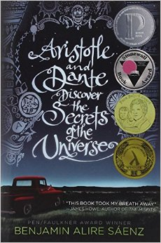
Students choose a book from the nominations list, read it, write a short analysis, and discuss it with other students in a round table book talk…and earn extra credit.

